Slide 1



University Institute of Engineering
DEPARTMENT OF COMPUTER SCIENCE & ENGINEERING
Subject Name: Software Engineering
Subject Code: 23CST-206
Software Design
Er. Jagmeet Kaur
E8387
ASSISTANT PROFESSOR
CSE
DISCOVER . LEARN . EMPOWER

Slide 2
Chapter-4 Software Design
The Design Model

Slide 3
Design Model
A design model in Software Engineering is an object-based picture or pictures that represent the use cases for a system.
Or to put it another way, it is the means to describe a system's implementation and source code in a diagrammatic fashion.
This type of representation has a couple of advantages.
First, it is a simpler representation than words alone.
Second, a group of people can look at these simple diagrams and quickly get the general idea behind a system. In the end, it boils down to the old adage, 'a picture is worth a thousand words.'

Slide 4
Types of Design Elements
Data design elements
The data design element produced a model of data that represent a high level of abstraction.
This model is then more refined into more implementation specific representation which is processed by the computer based system.
The structure of data is the most important part of the software design.

Slide 5
Types of Design Elements
Architectural design elements The architecture design elements provides us overall view of the system.
The architectural design element is generally represented as a set of interconnected subsystem that are derived from analysis packages in the requirement model.
The architecture model is derived from following sources: The information about the application domain to built the software.
Requirement model elements like data flow diagram or analysis classes, relationship and collaboration between them.
The architectural style and pattern as per availability.

Slide 6
Types of Design Elements
Interface design elements The interface design elements for software represents the information flow within it and out of the system.
They communicate between the components defined as part of architecture.
Following are the important elements of the interface design: 1. The user interface 2. The external interface to the other systems, networks etc. 3. The internal interface between various components.

Slide 7
Types of Design Elements
Component level diagram elements The component level design for software is similar to the set of detailed specification of each room in a house.
The component level design for the software completely describes the internal details of the each software component.
The processing of data structure occurs in a component and an interface which allows all the component operations.
In a context of object-oriented software engineering, a component shown in a UML diagram.
The UML diagram is used to represent the processing logic.

Slide 8

Types of Design Elements

Slide 9
Types of Design Elements
Deployment level design elements The deployment level design element shows the software functionality and subsystem that allocated in the physical computing environment which support the software.
Following figure shows three computing environment as shown. These are the personal computer, the CPI server and the Control panel.

Slide 10
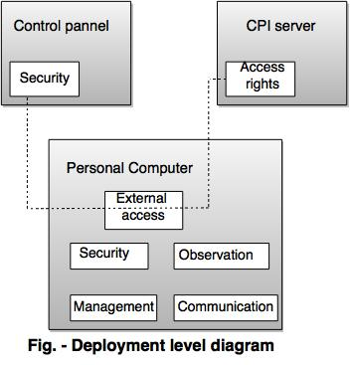

Slide 11
References
https://www.tutorialspoint.com/software_engineering/software_design_basics.htm#:~:text=Software%20design%20is%20a%20process,in%20software%20coding%20and%20implementation.&text=Software%20design%20is%20the%20first,problem%20domain%20to%20solution%20domain.
https://www.geeksforgeeks.org/software-engineering-software-design-process/
https://www.javatpoint.com/software-engineering-software-design

Slide 12
THANK YOU

